Slide 1
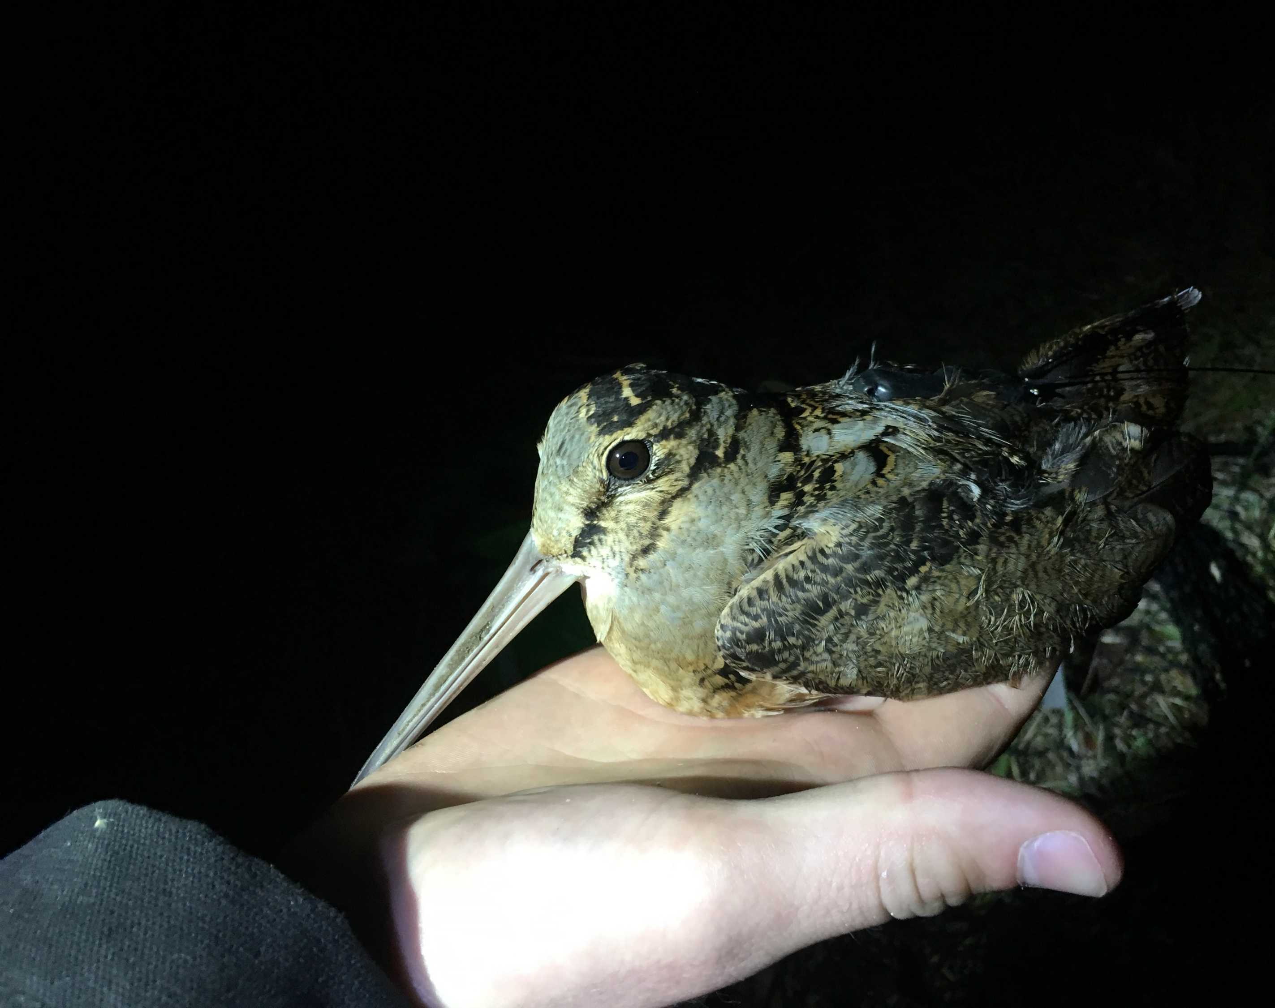
Woodcock Habitat Modeling
First quarterly update, 11/5/2020
Liam Berigan

Slide 2
Review of last meeting
 | Migratory locations | Resident locations | Total
Public land | 17 | 287 | 304
Private land | 230 | 294 | 524
Total | 247 | 581 | 828
 | Migratory locations | Resident locations | Total
Male | 125 | 292 | 417
Female | 122 | 289 | 411
Total | 247 | 581 | 828
Combined: 88 birds, mean 9.4 points per bird (43 individuals with < 3 points)
Locations as of July 2020

Slide 3
Review of last meeting
Two models:
Migratory model: focused on statewide layers
Residential model: all statewide layers, but with additional state game land layers
Anticipated use for the product is to determine which state lands could host woodcock stopover habitat given appropriate management

Slide 4
Proposed Timeline
November 2020
Assemble habitat layers for the migratory model
January 2021
Have a draft product assembled for the migratory model
April 2021
Have a draft product assembled for the residential model
July 2021
All final products prepared

Slide 5



Current progress with migratory variables
Potential Predictive Variables for Migratory Habitat Model
Soil Variables | Land Cover | Landscape Configuration
Soil drainage class | LANDFIRE land use/land cover (point and buffered) | Landcover-specific edge coefficient
Topographic wetness index | LANDFIRE forest type (point and buffered) | General edge coefficient
Soil texture |  | Size of nearest forest patch
 |  | Forest Aggregation Index
 |  | Patch Cohesion Index
 |  | Percent of landscape which is forested
Informative in exploratory analysis
Uninformative in exploratory analysis
Built, no results yet

Slide 6
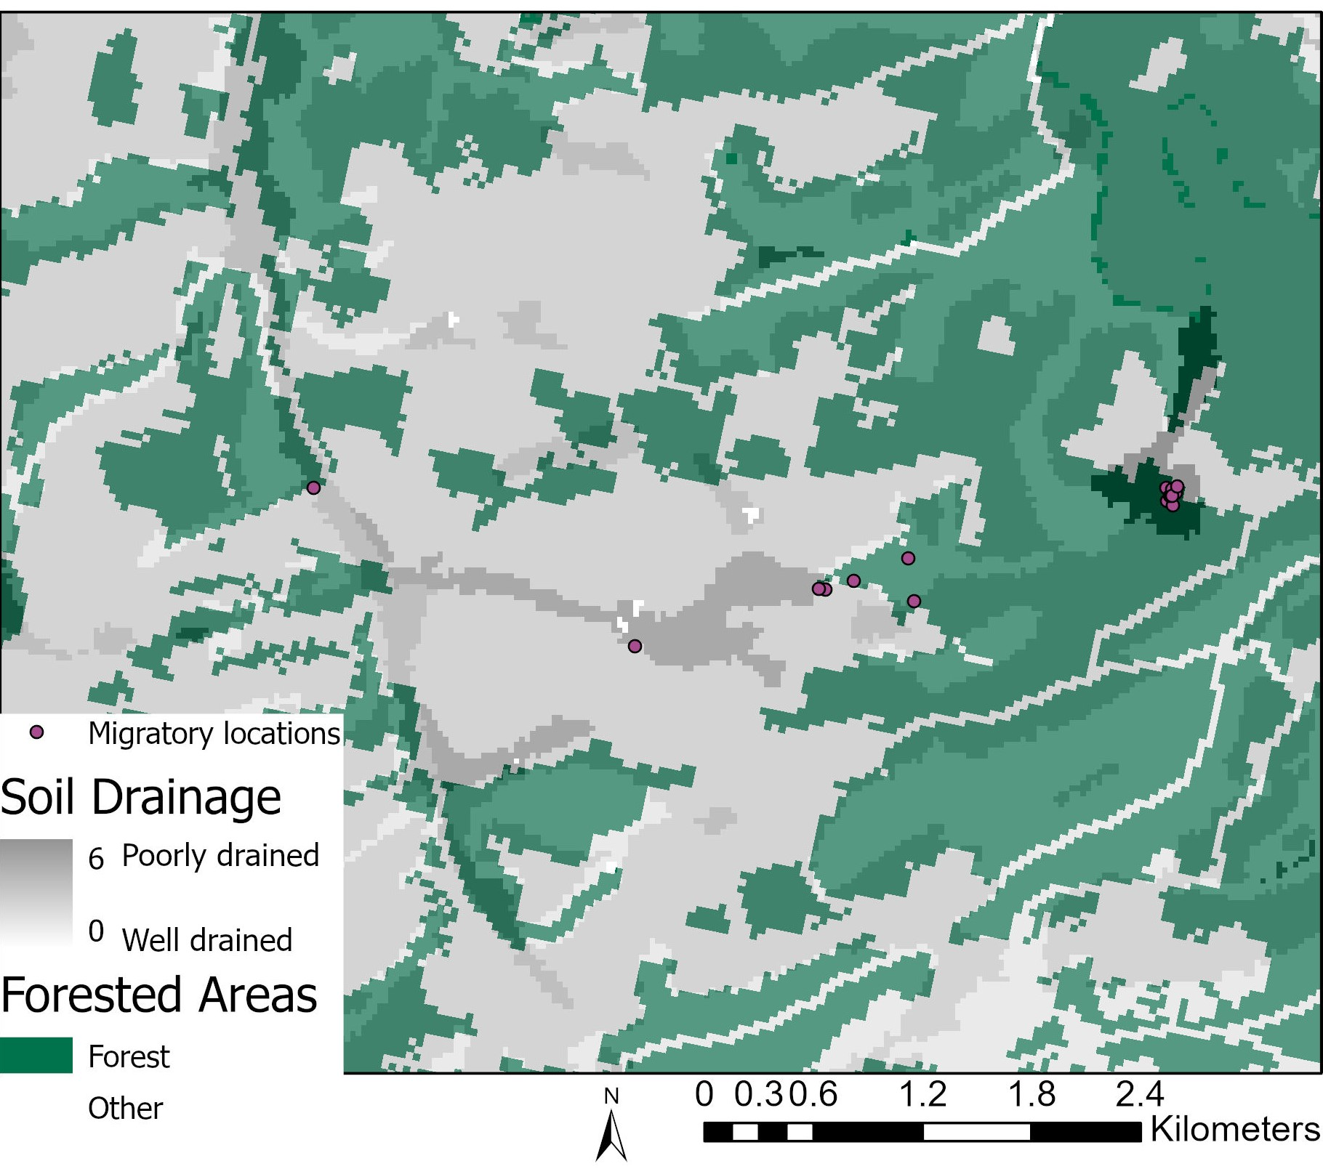
Preliminary results
Strong selection for:
Forest edges (within 200m)
Poorly drained soils
Little selection for:
Land cover

Slide 7
Preliminary results
Leaning away from modeling young forest
Delays in LIDAR products
Ensure this layer doesn’t expire within a few years
Highlight where management could occur, instead of where it already is

Slide 8
Integrating landscape metrics
Landscape composition:
How much of the surrounding landscape needs to be forest before it’s used?
Landscape configuration:
How large/connected do forest patches have to be before they’re useful to woodcock?

Slide 9
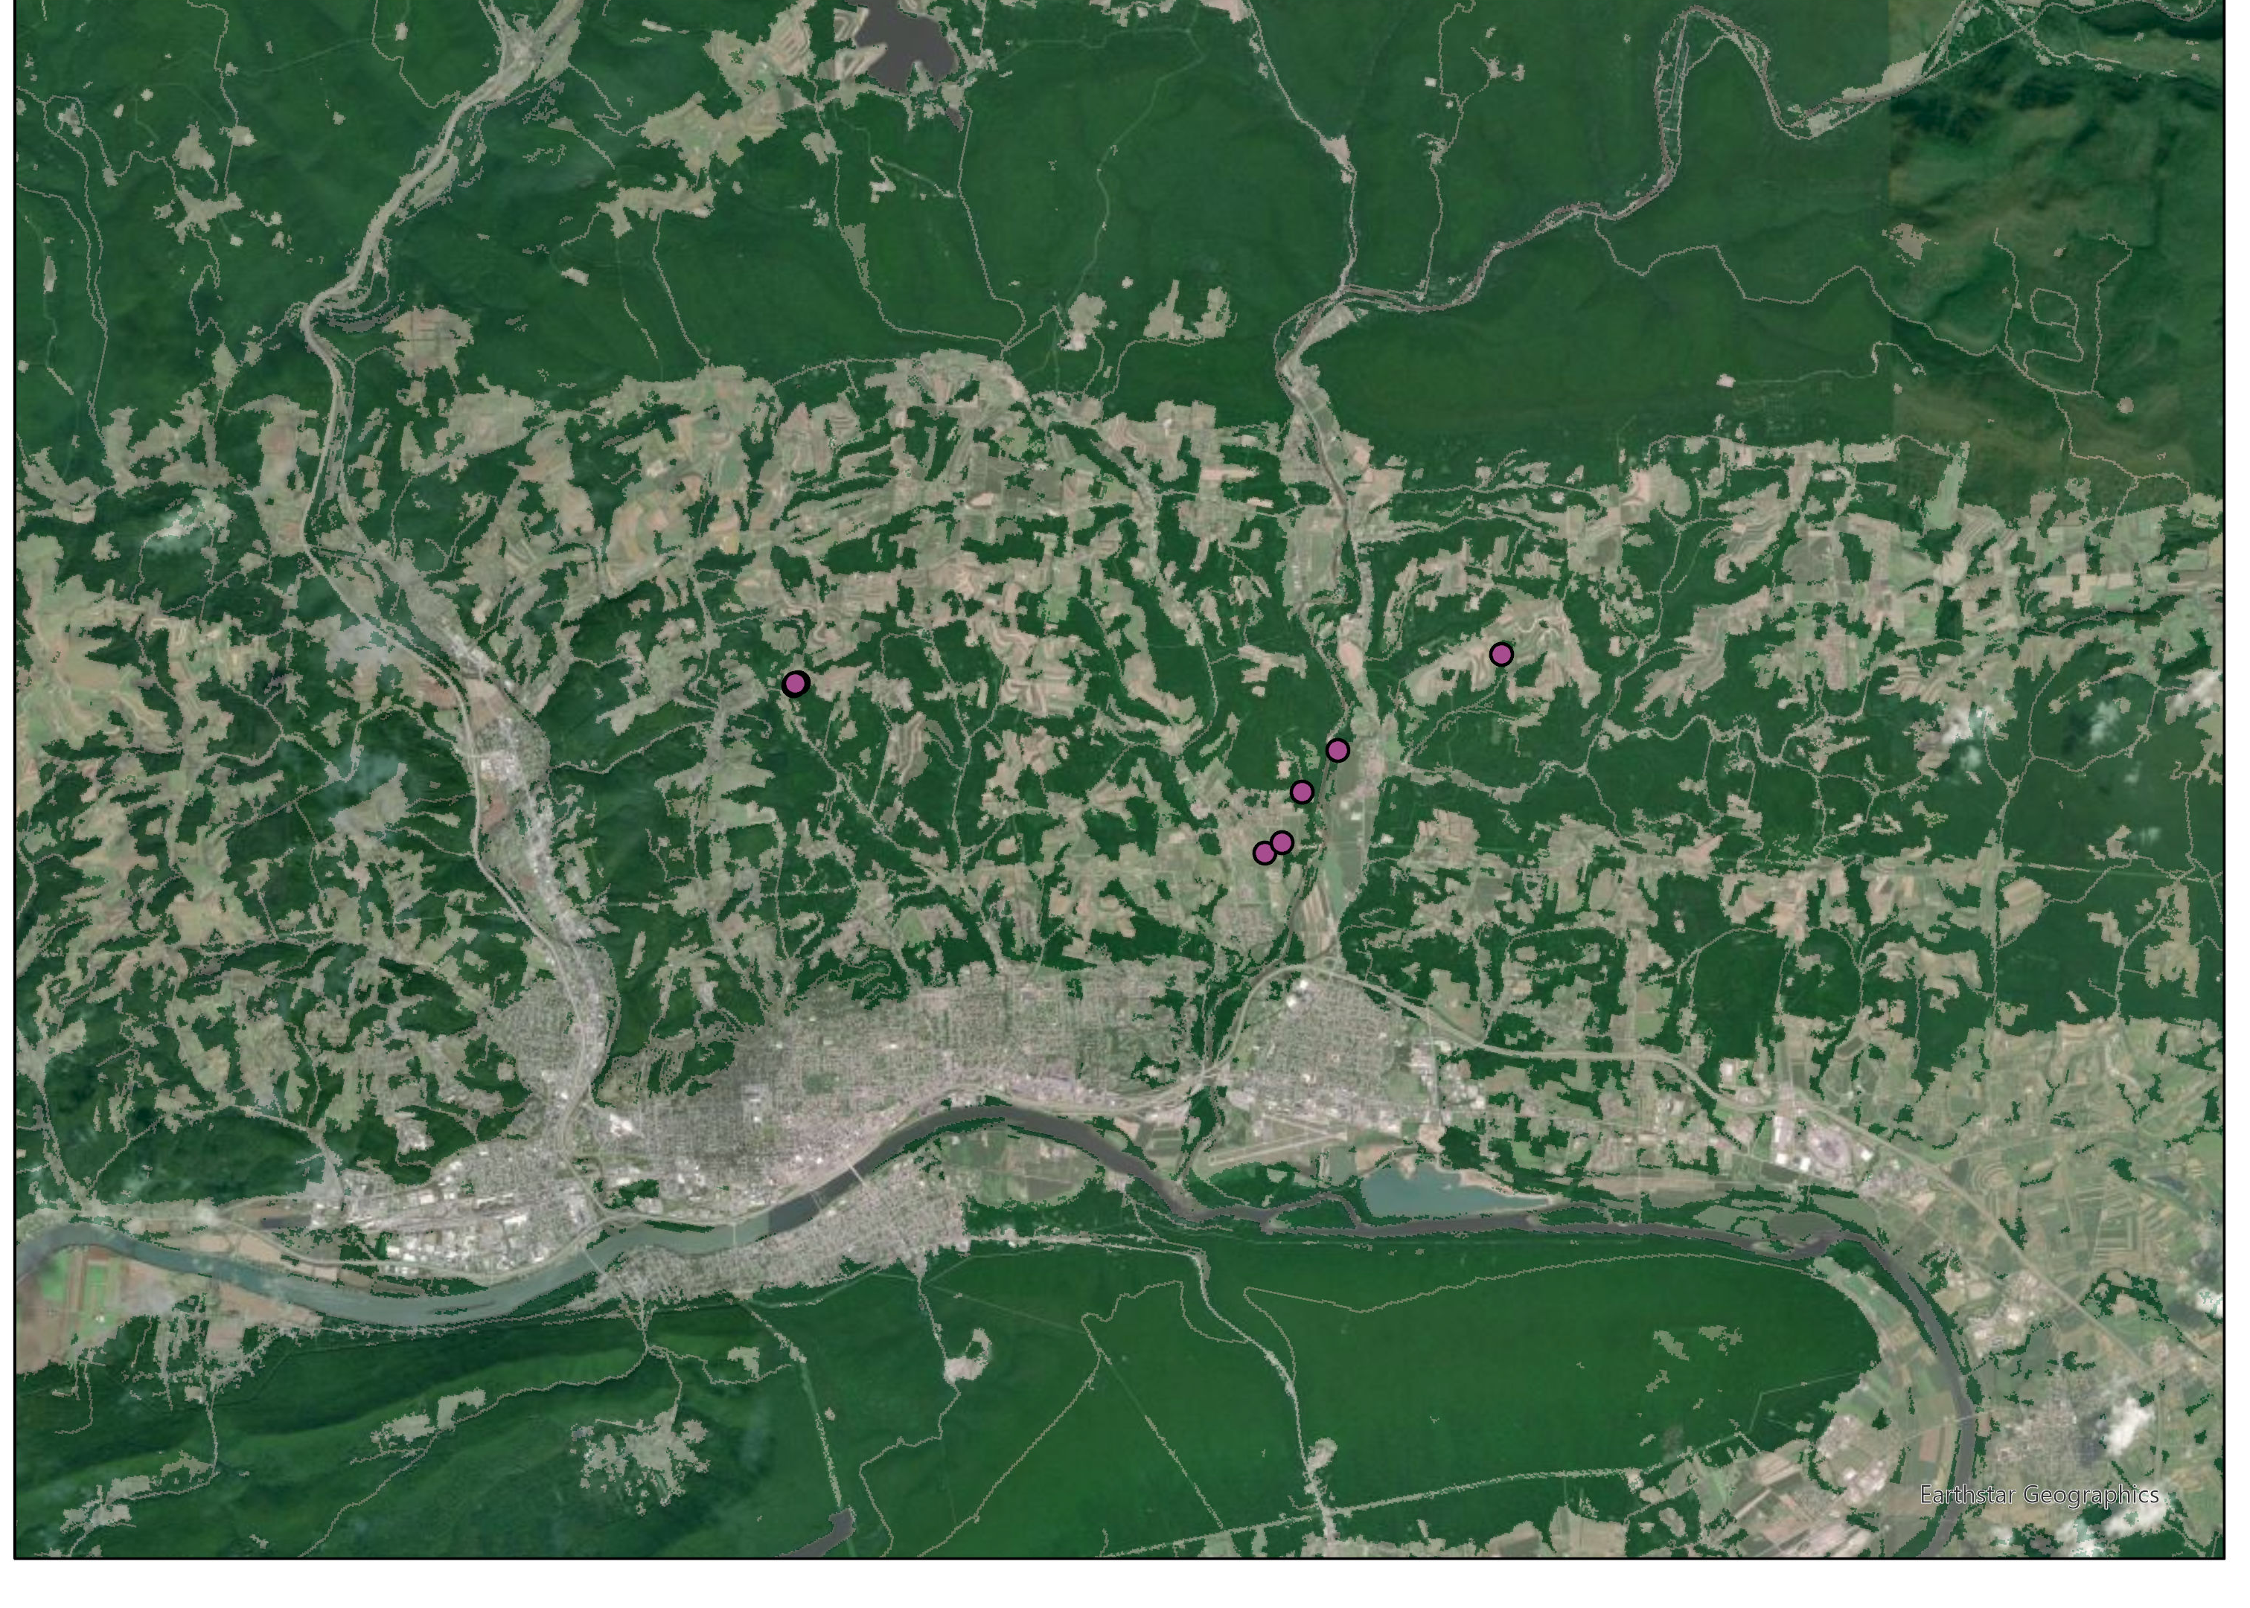
Integrating landscape metrics
Woodcock are clearly selecting for larger scale landscape characteristics
However, this selection is likely non-linear

Slide 10
Challenges associated with the next steps
Multiple locations per stopover causing spatial autocorrelation
Solve by either aggregating to a single location or using a modeling technique (spatial regression, mixed effects modeling)
Non-linearity in predictors
Quadratic variables in logistic regressions
Generalized Additive Models

Slide 11
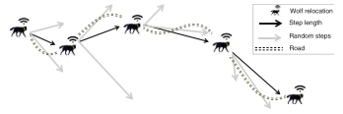
Modeling techniques we’re considering
Maximum entropy modeling
Machine learning program to identify a species’ niche on the landscape
Resource Selection Functions
Simulate available locations and compare habitat characteristics to used locations
Possible validation methods
K-fold cross validation
Withhold 10% for a testing dataset
Figure from Thurfjell et al. 2014

Slide 12
For next meeting (tentative Jan 2021):
Goal: Have a draft product assembled for the migratory model
Will use these layers to create a draft predictive surface highlighting areas where woodcock are more likely to stop over on migration
Focusing primarily on broader scale habitat factors
Landscape-scale approach to measuring habitat (moisture, composition, configuration)
Highlight which game lands are useful, but not predict where the woodcock will go within a unit

Slide 13

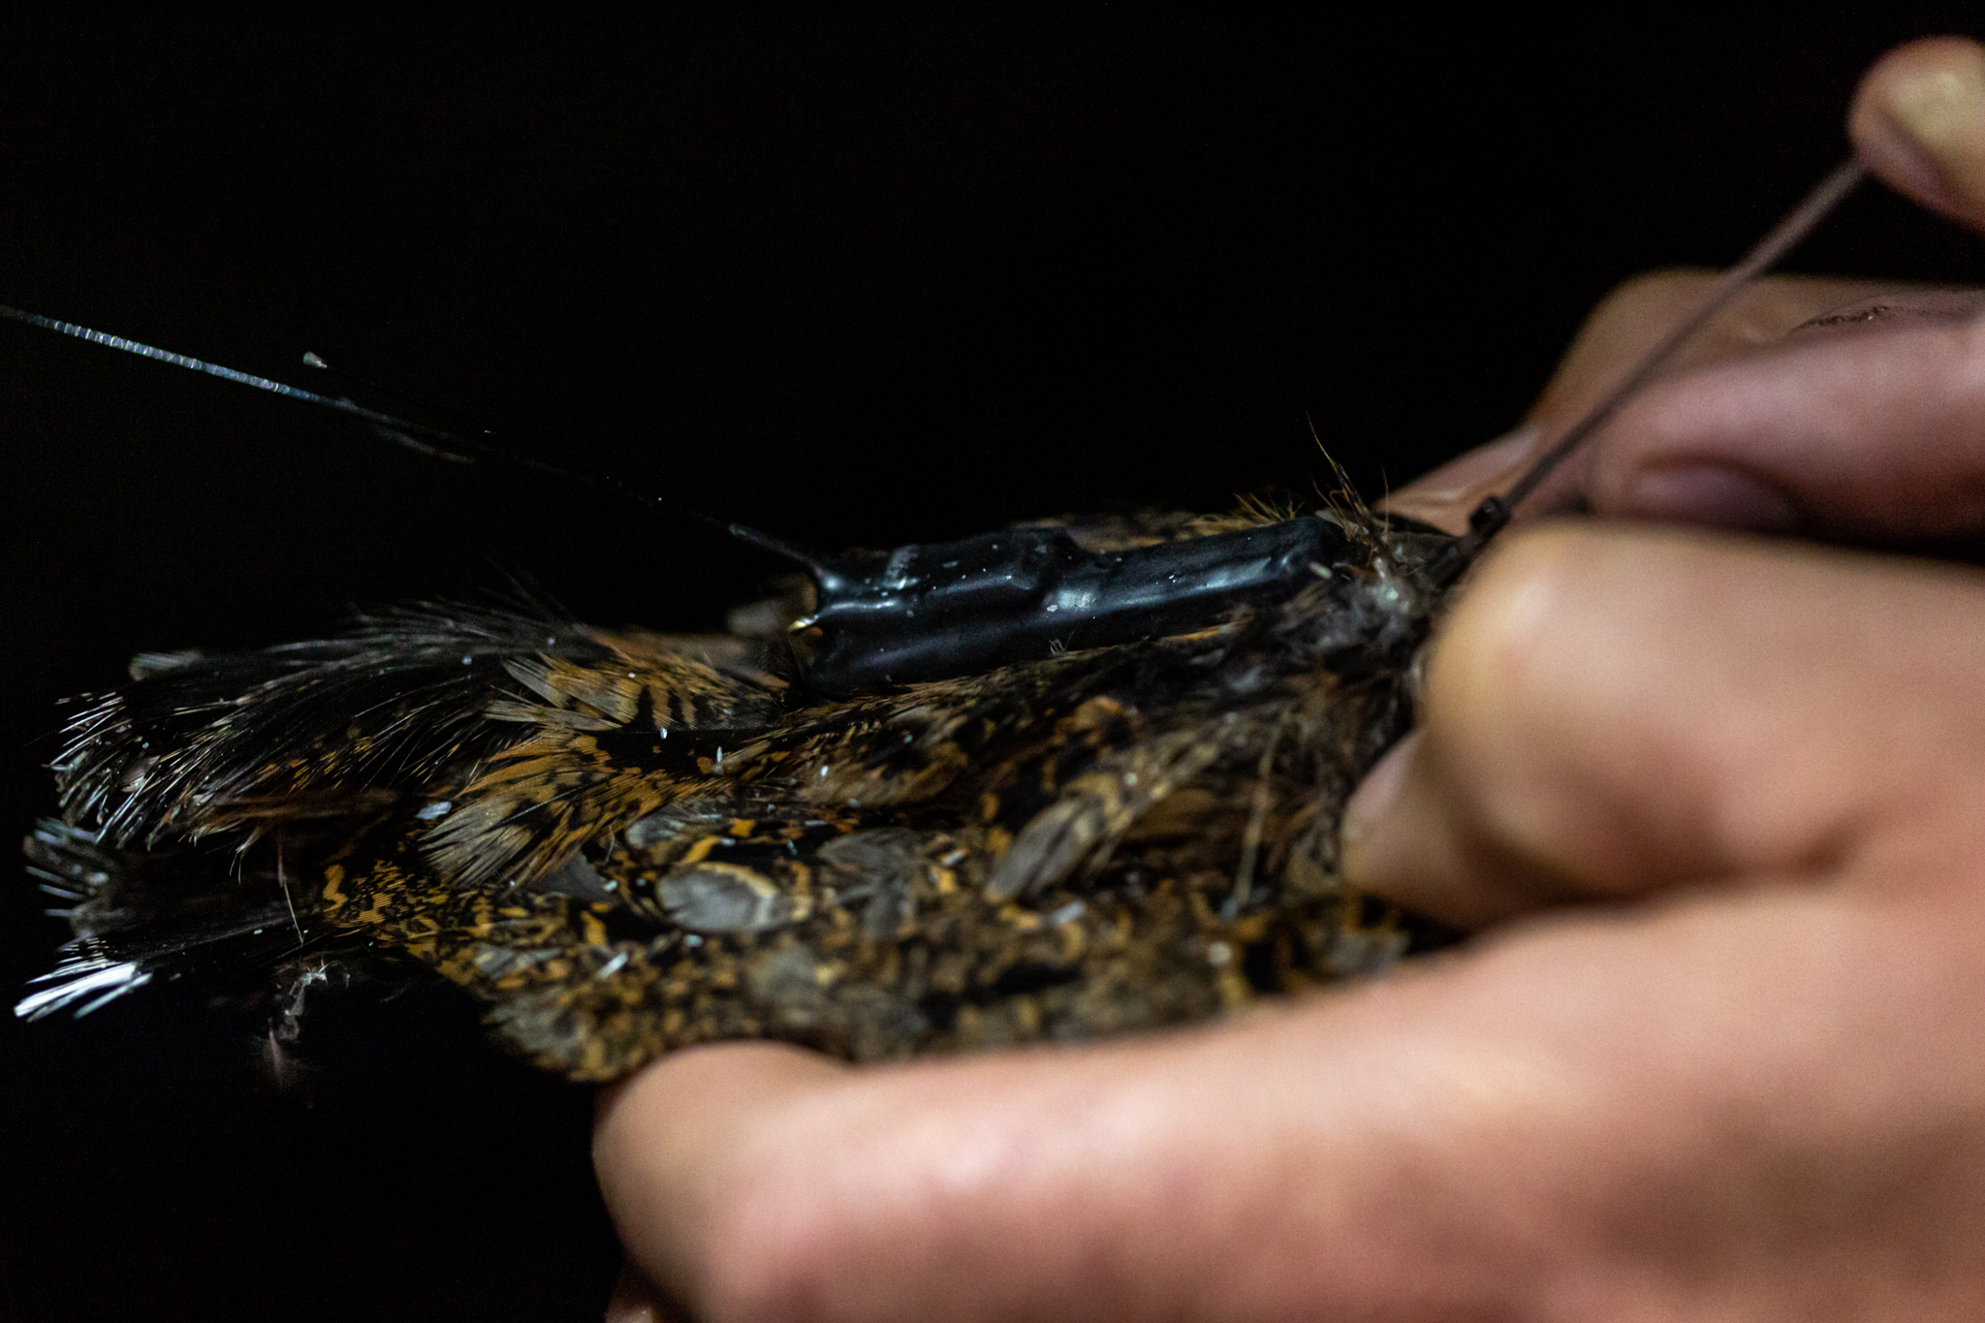
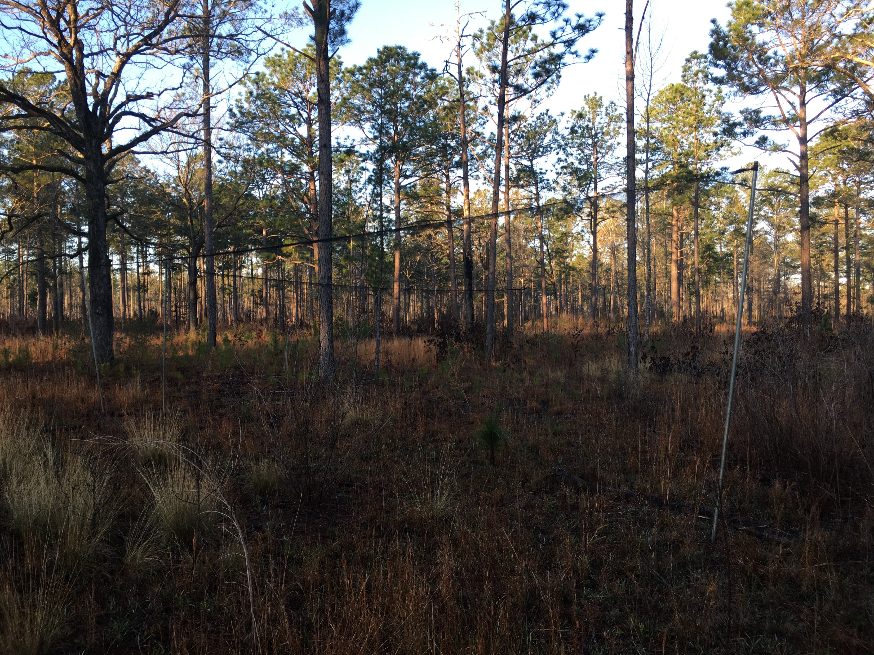
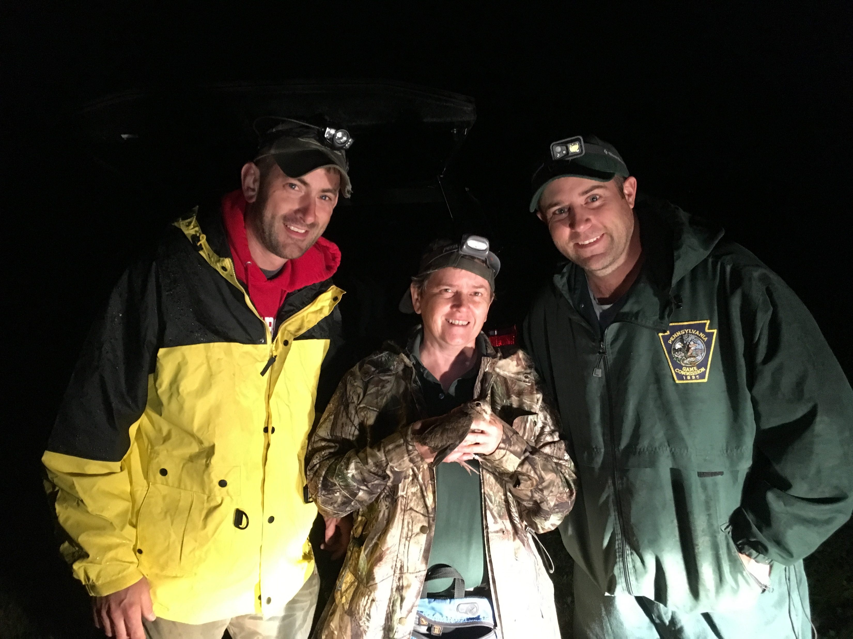
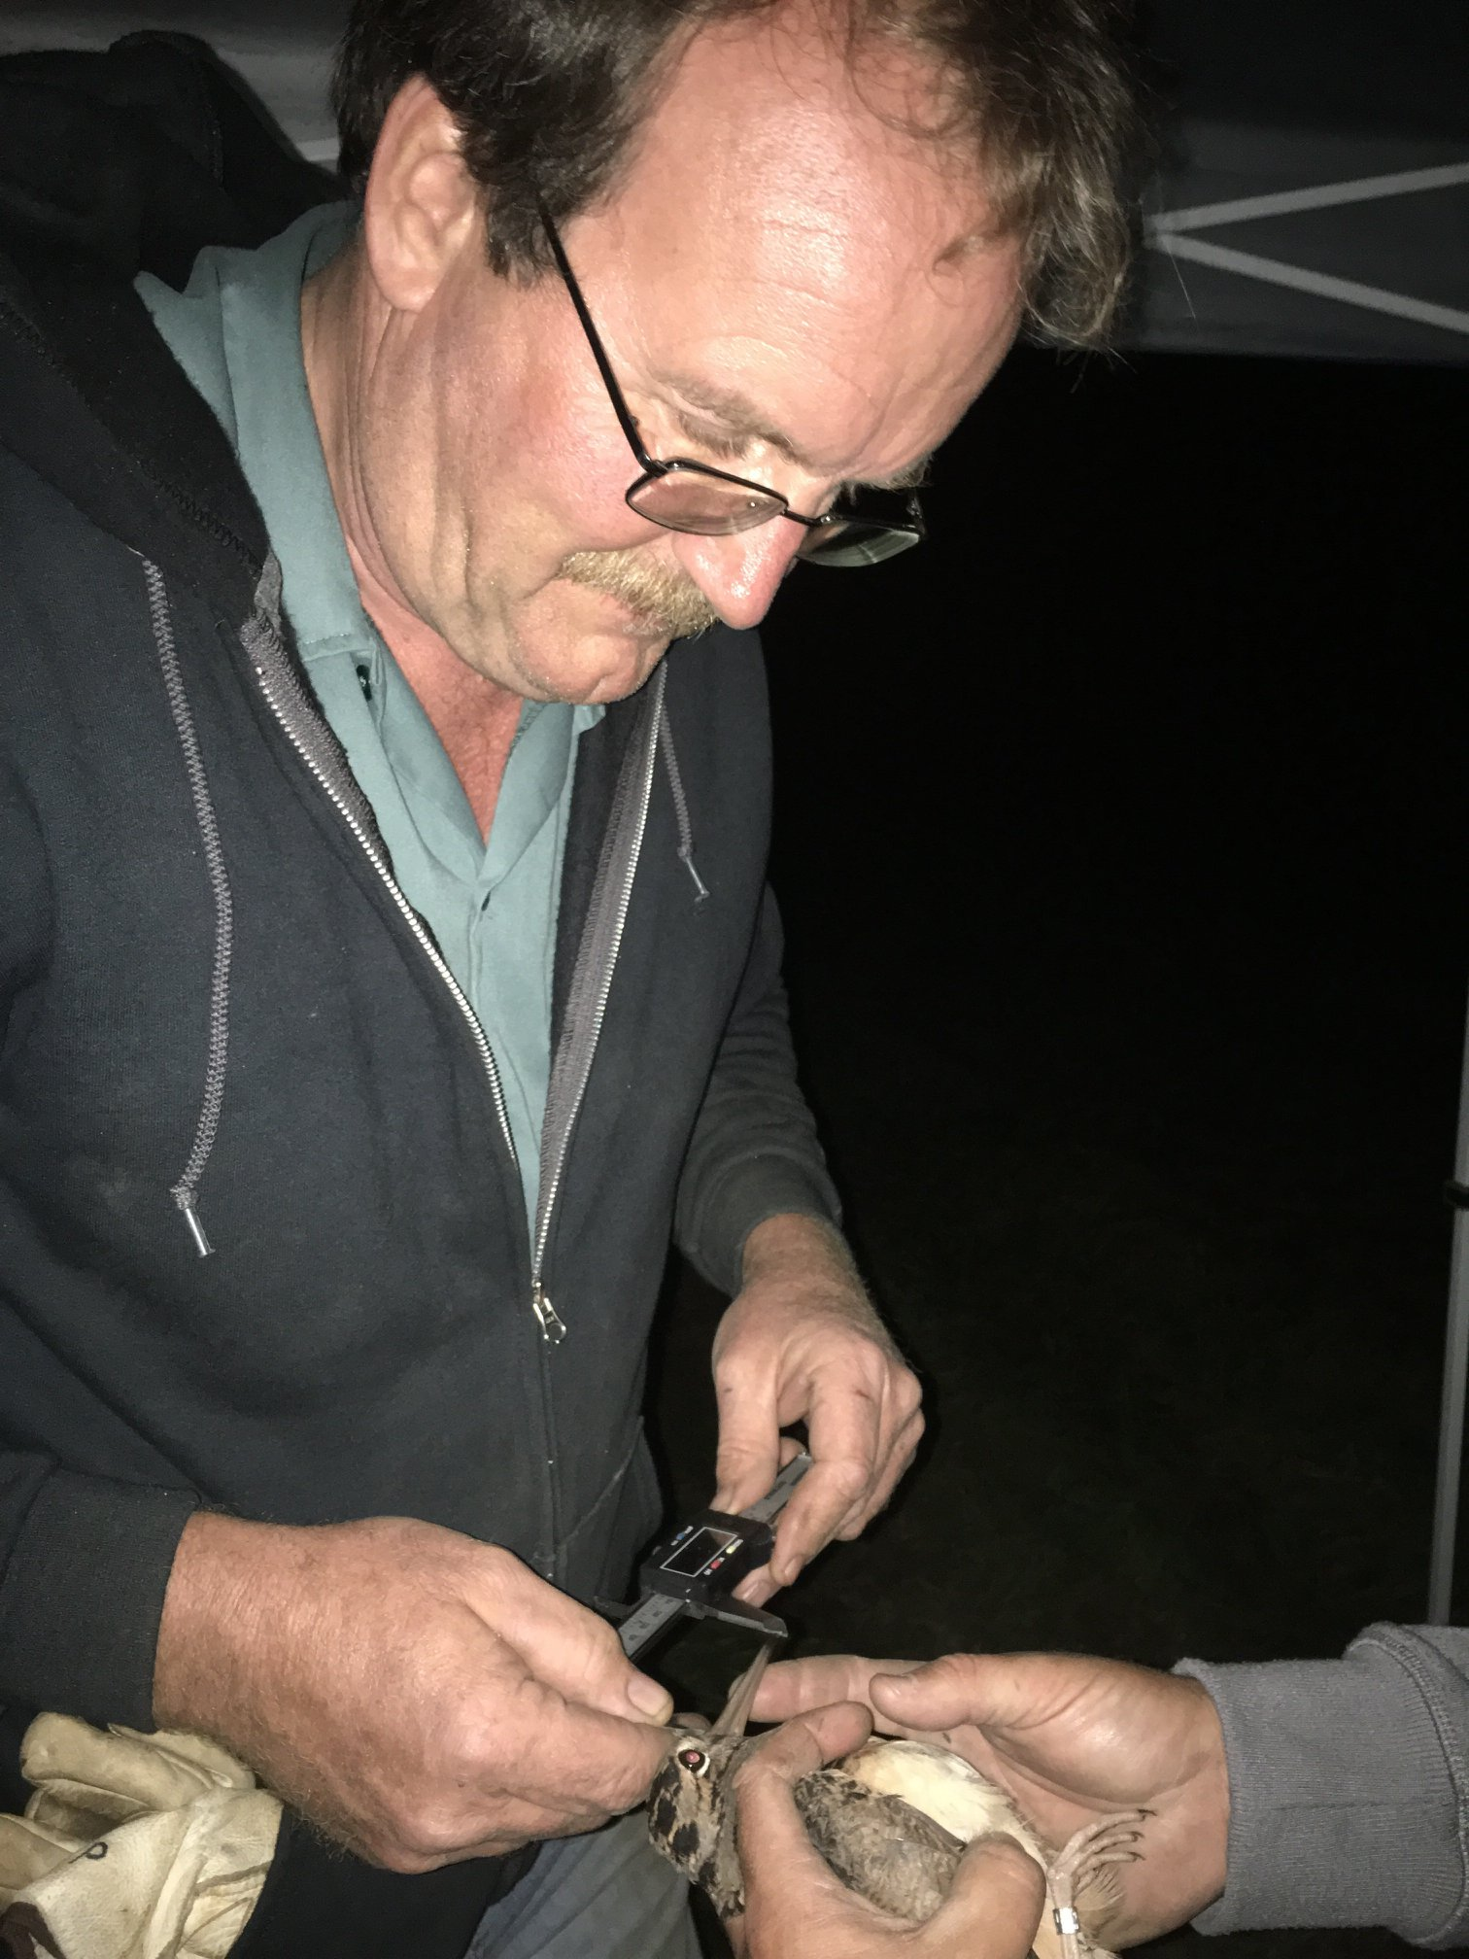
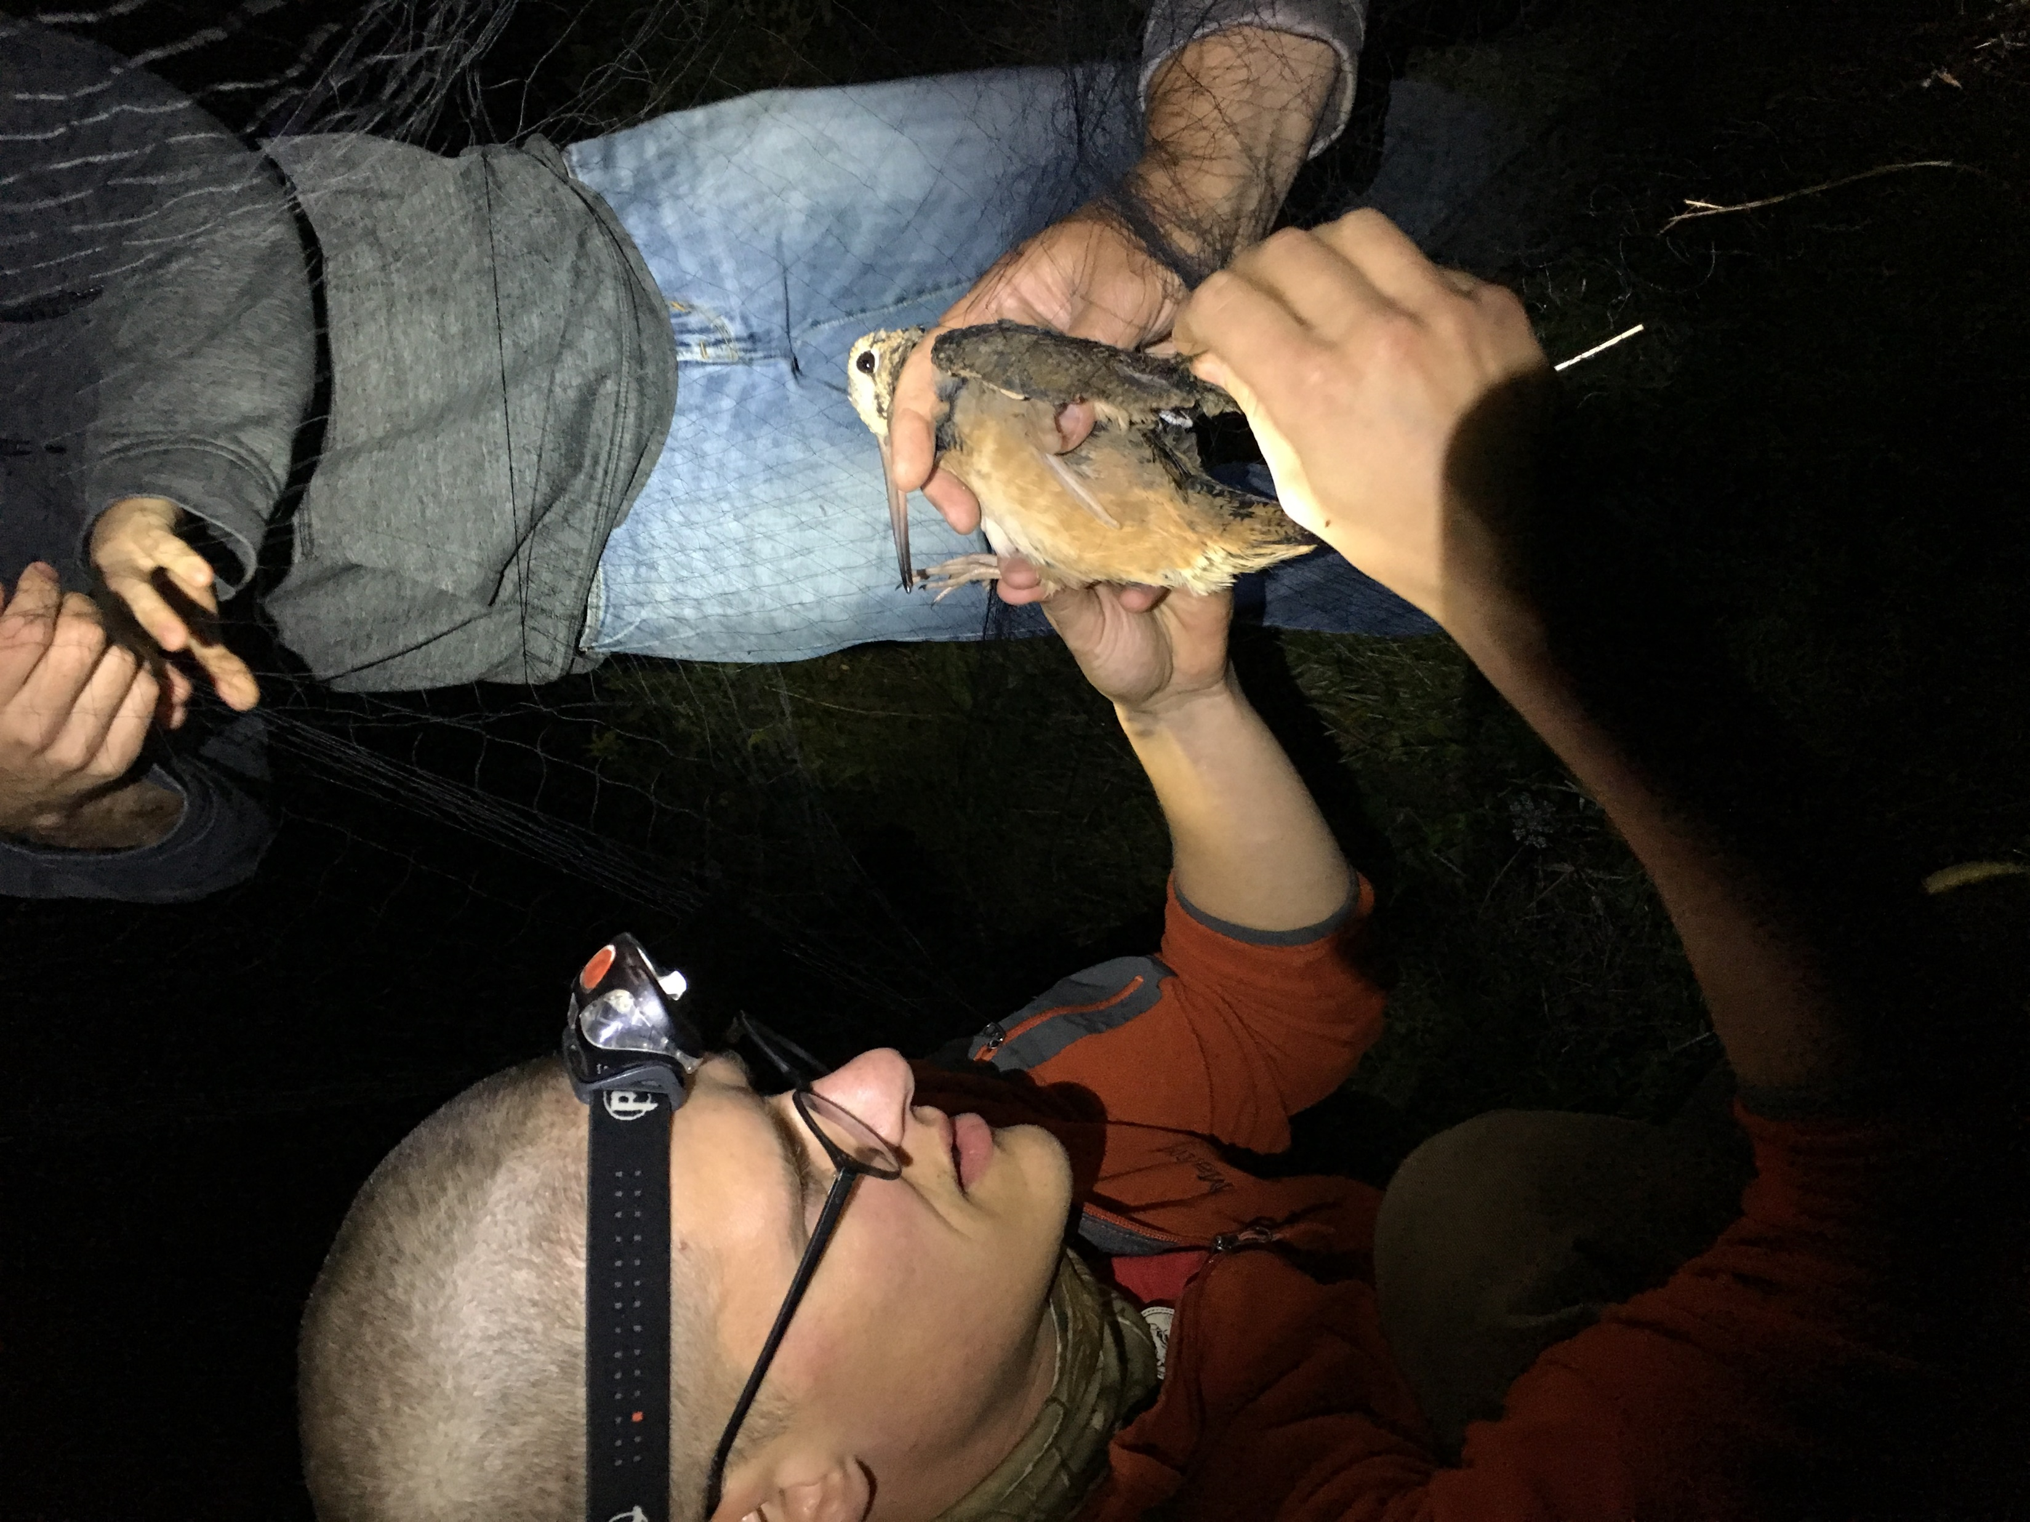
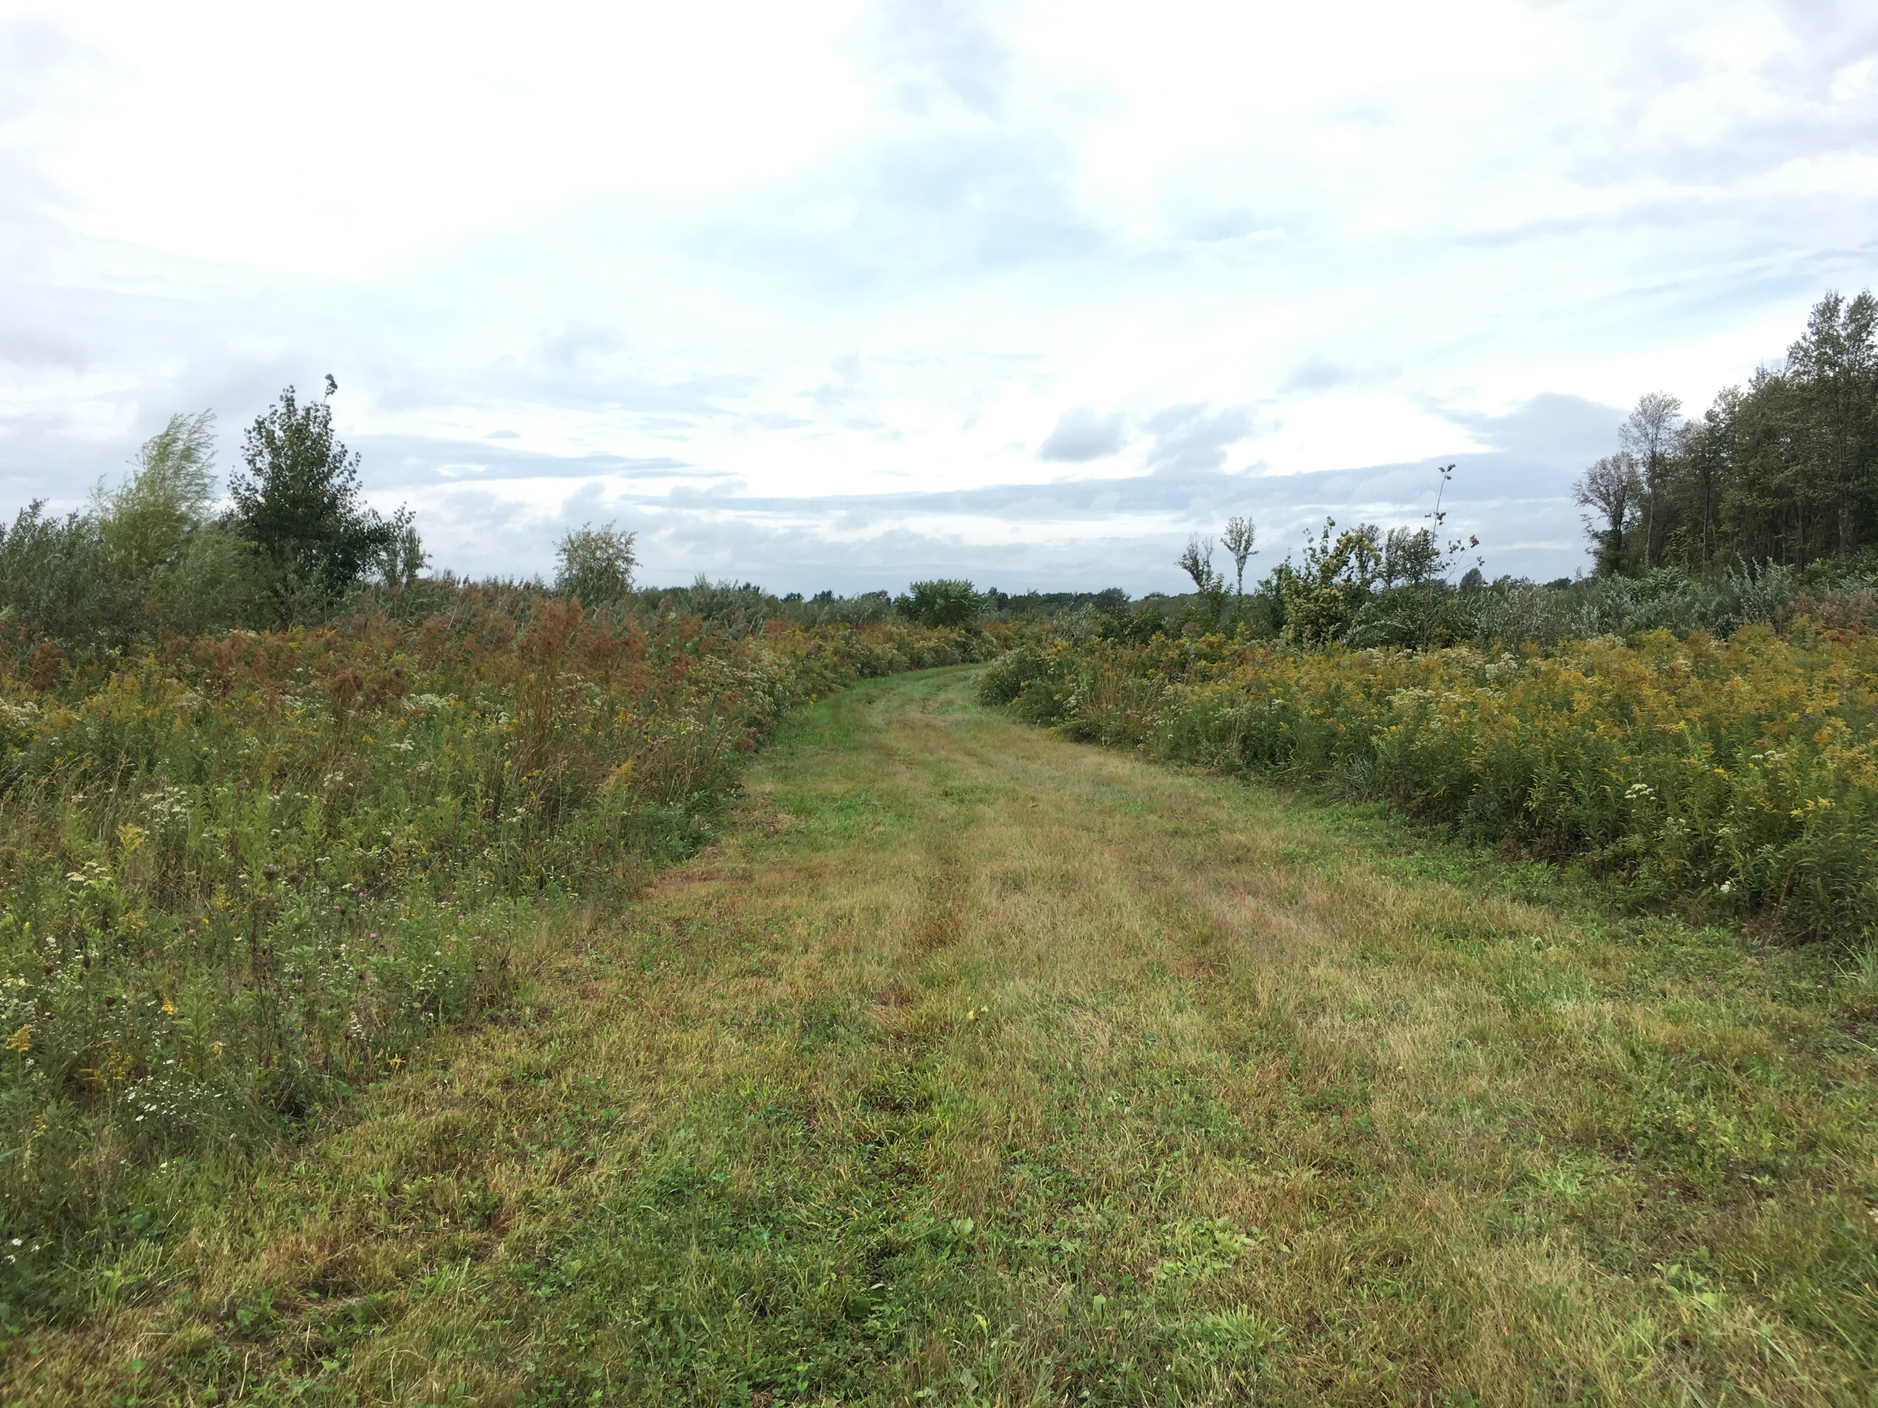
Thank you!

